Slide 1
Athletes are better students
Ali Awari

Slide 2
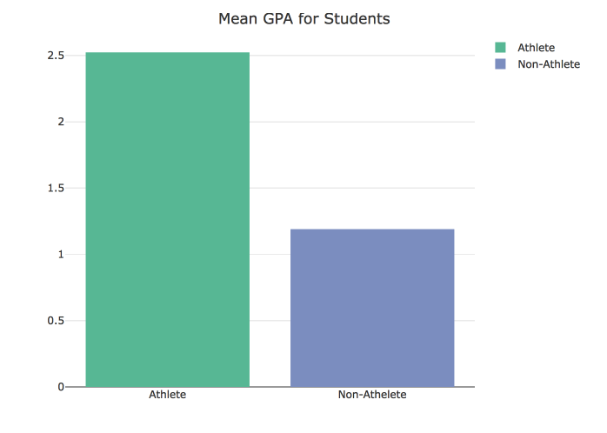
Mean GPA
Students with an athleticism higher than 5, and lower than 5, had their GPAs’ compared.

Slide 3
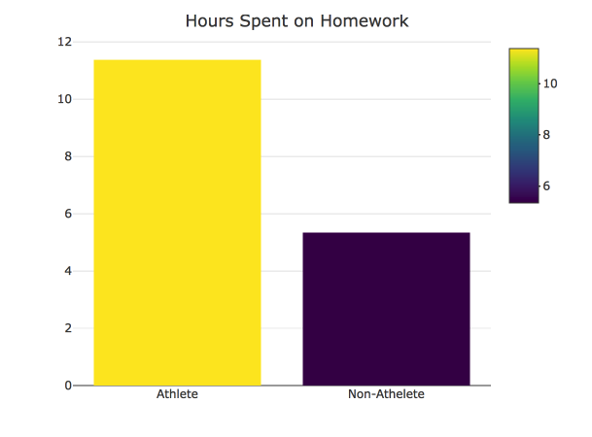
Hours Spent on Homework
Athletes on average spent more time on homework than non-athletes

Slide 4
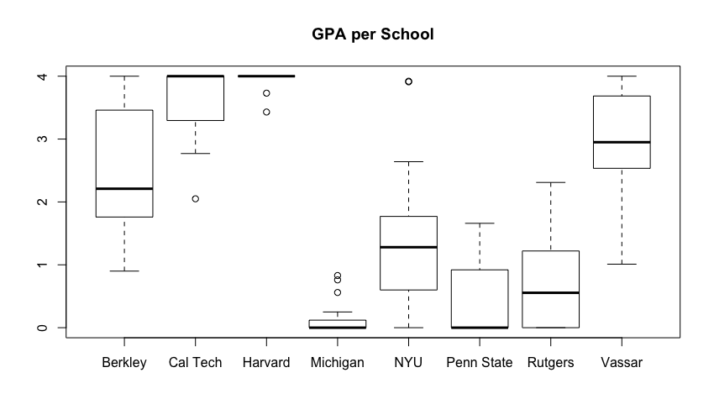
GPA per school
Most ivy leagues do well in terms of GPA
Penn state is worse than rutgers

Slide 5
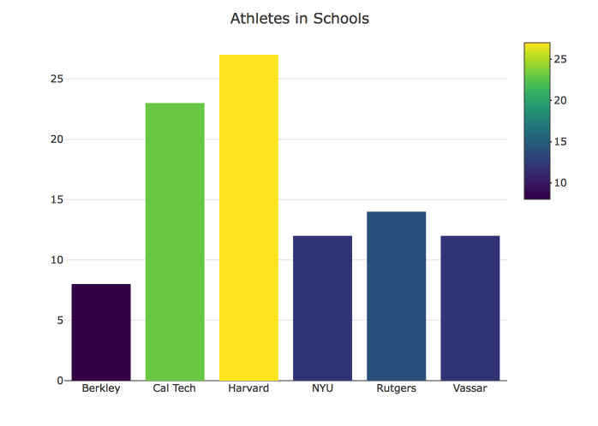
Athletes Per School
Cal Tech & Harvard has the most athletes
Schools with More athletes have a Higher average Gpa with the exception of Rutgers

Slide 6
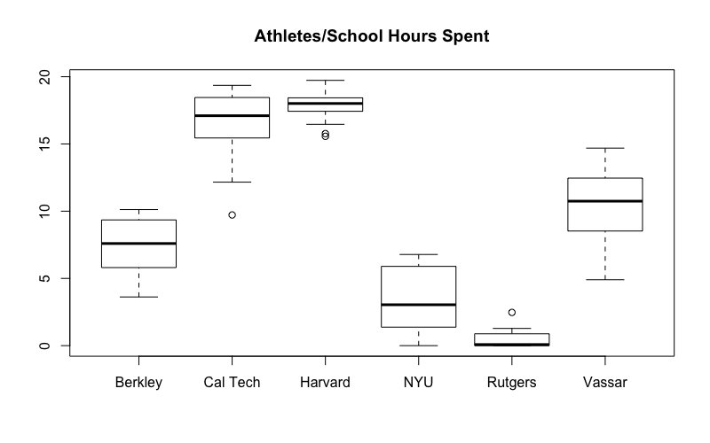
Athletes spend more time studying
Athletes spend more hours studying at these Schools as well.

Slide 7
Conclusion
Athletes spend more time studying
Athletes get into better schools
Athletes Get better grades overall

